Slide 1






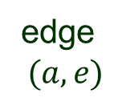

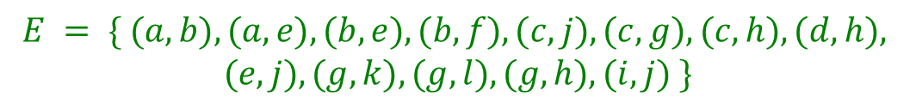









Graph
A graph$G=$ a set $V(G)$ of vertices (nodes)
+ a set $E(G)$ of edges (pairs of vertices)
vertex
$a$
$$b$$
$$c$$
$$d$$
edge
$$(a, e)$$
$$e$$
$$f$$
$$g$$
$$h$$
$$i$$
$$j$$
$$k$$
$$l$$
$$V = \{ a, b, c, d, e, f, g, h, i, j, k, l \}$$
$$\left|V\right|=12$$
$$E = \{ (a, b), (a, e), (b, e), (b, f), (c, j), (c, g), (c, h), (d, h),$$
$$(e, j), (g, k), (g, l), (g, h), (i, j) \}$$
$$\left|E\right|=13$$

Slide 2
A Directed Graph
In a directed graph (digraph), edges are ordered pairs.
DL 435
BOS
ORD
AA 2175
SFO
JFK
AA 1086
DL 434
UA 5654
UA 3606
UA 293
AA 1223
MIA
AA 2467
AA 207
LAX
DFW
AA 2435

Slide 3
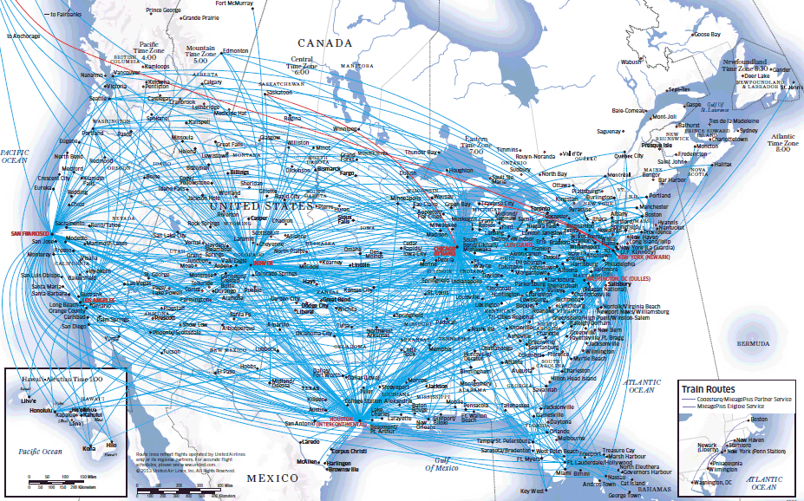
United Airlines Route Map

Slide 4
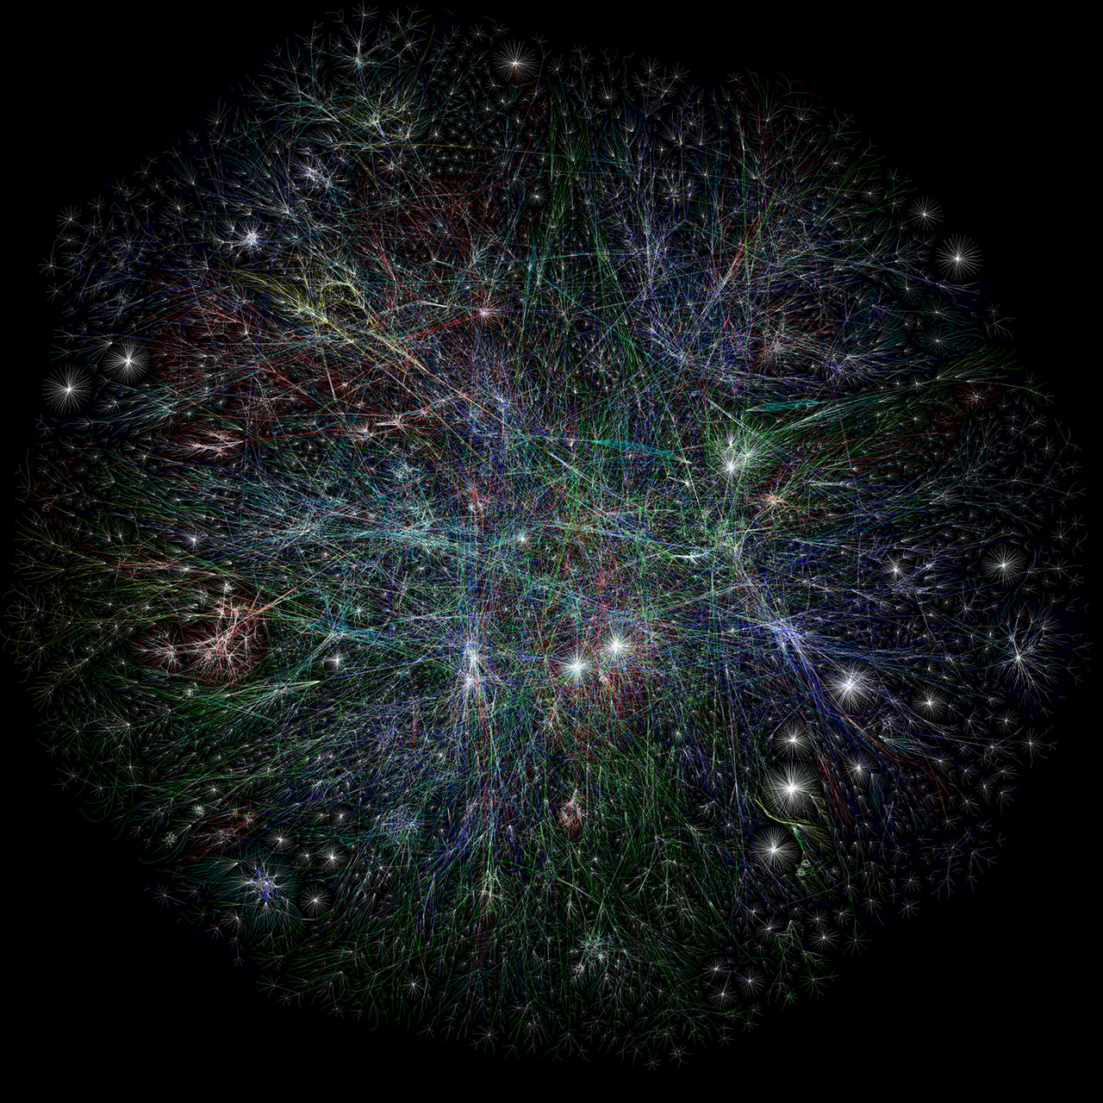
Internet

Slide 5
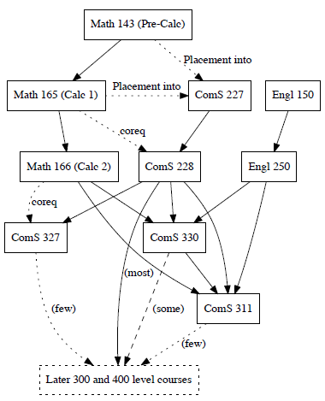
Course Prerequisites

Slide 6
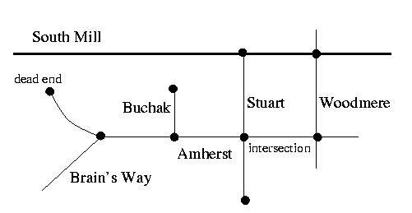
Streets / Highways (Roadmaps)

Slide 7
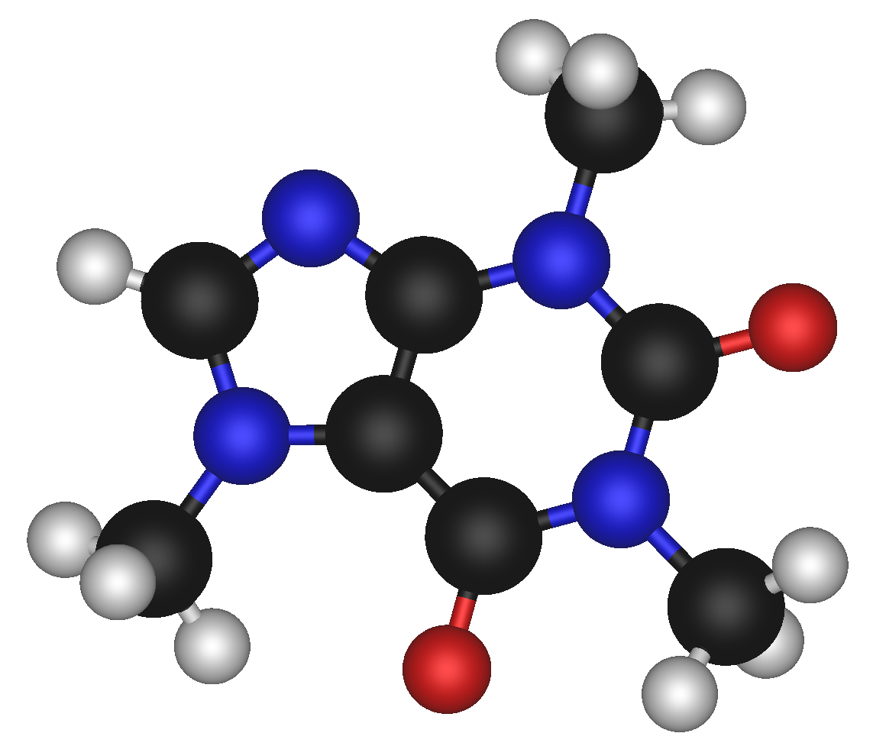
Molecular Structures
Notes:
Caffeine molecule

Slide 8
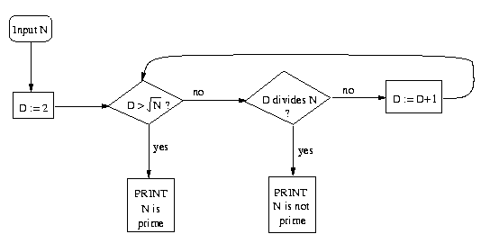
Flow Charts

Slide 9
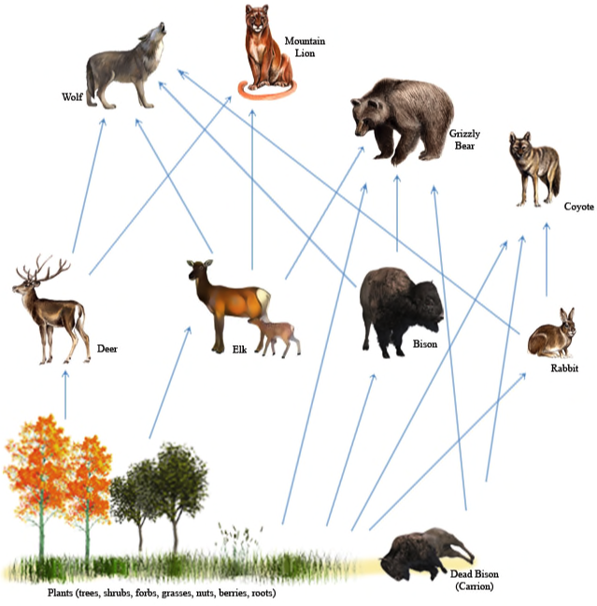
Food Webs

Slide 10
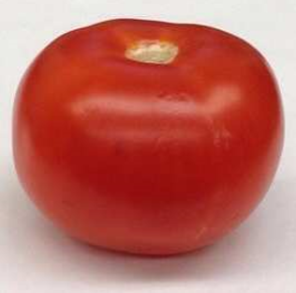
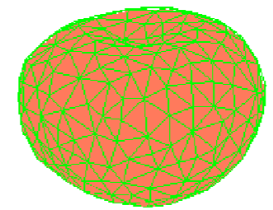
Triangular Meshes

Slide 11






Social Networks
George
Paul
Yoko
John
Ringo
Linda

Slide 12



More General Graphs
A multipgraph allows multiple edges between two vertices.
$$a$$
$$c$$
$$b$$
$$d$$
$$f$$
A pseudograph is a multigraph that allows loops (edges from a vertex
to itself).
1
2
3
4
5
6

Slide 13



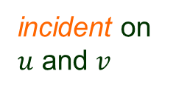






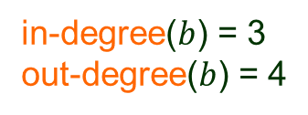




Edges & Degrees
deg($w$) = 1
$$e_{2}$$
$$w$$
$$u$$
$u$ and $v$ are adjacent
degree($u$) = 2
endpoint
$$e_{1}$$
$$v$$
incident on
$u$ and $v$
in-degree($b$) = 3
out-degree($b$) = 4
$$c$$
source
$$b$$
$$a$$
$$e$$
destination/target
$$d$$

Slide 14

Handshaking Theorem
Let $G = (V, E)$be an undirected simple graph.
∑
Every edge contributes 1 to each of
the degrees of its endpoints.
deg(v) = 2 | E |
v ∈ V
v
deg(u) = 1
deg(w)=deg(x)=2
deg(v) = 3
u
x
w
If $G$ is directed:
(1+2+2+3)/2 = 4 edges
∑
∑
in-deg(v) = out-deg(v) = | E |
v ∈ V
v ∈ V
Every edge contributes 1 to the out-degree of its
source and 1 to the in-degree of its destination.

Slide 15








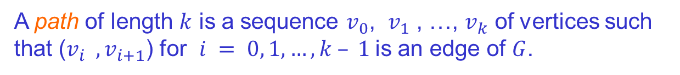

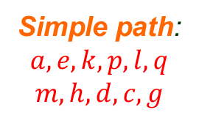





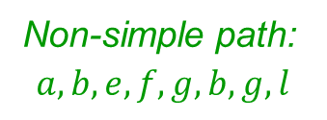



Path
A path of length $k$ is a sequence $v_{0}$, $v_{1}$ , …, $v_{k}$ of vertices such
that ($v_{i} , v_{i+1}$) for $i = 0, 1, …, k – 1$is an edge of $G$.
$b, c, d$not a path
$$a$$
$$b$$
$$c$$
$$d$$
Simple path:
$$a, e, k, p, l, q$$
$$m, h, d, c, g$$
$$e$$
$$f$$
$$g$$
$$h$$
(no repeated
vertices)
Non-simple path:
$$a, b, e, f, g, b, g, l$$
$$j$$
$$k$$
$$l$$
$$m$$
$$n$$
$$o$$
$$p$$
$$q$$

Slide 16
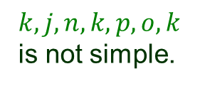
Cycle
A cycle is a path that starts and ends at the same vertex.
A simple cycle has no repeated vertices.
a
b
c
d
e
f
$$g$$
h
j
k
l
m
$$k, j, n, k, p, o,k$$
is not simple.
n
o
p
q

Slide 17

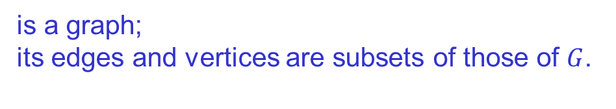
Subgraph
A subgraph $H$ of $G$
is a graph;
its edges and vertices are subsets of those of $G$.
a
b
c
d
e
f
$$g$$
h
j
k
l
m
n
o
p
q
$V(H)$ $= \{b, d, e, f, g, h, l, p, q\} E(H)$ = $\{(b, e), (b, g), (e, f), (d, h), (l, p), (l, q)\}$

Slide 18












Connectivity
$G$ is connected if there is a path between every pair of vertices.
$$a$$
$$d$$
$$b$$
$$c$$
$$f$$
$$e$$
If $G$ is not connected, the maximally connected subgraphs are the
connected components of $G$.
C
3
C
2
C
$$a$$
1
$$d$$
$$e$$
$$f$$
$$g$$
$$b$$
$$a$$
?
not maximally
connected
$$c$$
$$d$$

Slide 19


Is a Tree Connected?
Yes, and $| E | = | V | – 1$.
#edges #vertices
If $G$ is connected, then $| E | ≥ | V | – 1$.

Slide 20

Strong & Weak Connectivity
A directed graph is strongly connected if every two vertices are
reachable from each other.
?
b
a
b
a
e
e
f
c
d
d
c
$c$ unreachable from others
It is weakly connected if the underlying undirected graph is connected.
c
c
f
a
f
b
b
a
e
e
d
d

Slide 21
Weighted Graphs
Ex. Home construction schedule
Outside
Plumbing
Inside
Plumbing
9 days
10 days
8 days
5 days
Framing
21 days
End
Start
7 days
19 days
12 days
6 days
2 days
Concrete
Sewer
Connection
Roofing

Slide 22
Input and Output of Graphs
4
Input data:
B
2
3
A
5 // 5 vertices
A B C D E
6 // six edges
A B 4
A C 7
A D 6
B A 2
C B 3
C E 2
D E 4
E C 1
7
6
1
C
4
D
E
2
Output:
A: in-degree 1 out-degree 3
Edges: B (4) C (7) D(6)
B: in-degree 2 out-degree 1
Edges: A (2)
C: in-degree 2 out-degree 2
Edges: B (3) E (2)
D: in-degree 1 out-degree 1
Edges: E (4)
E: in-degree 2 out-degree 1
Edges: C (1)

Slide 23
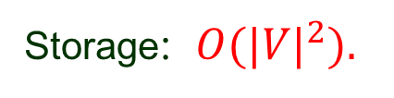

Adjacency Matrix
bool A[n][n];
1
true if $(i, j) ∈ E(G)$
A[i][j] =
0
2
false otherwise
0 1 2 3 4
4
3
0 false true true false true
1 true false true false false
2 true true false true true
3 false false true false true
4 true false true true false
Storage: $O({|V|}^{2}).$
Preferred when the graph is small or dense.

Slide 24

Adjacency Set / List
Vertices Set of Neighbors
B
A
B
2
C
5
E
7
2
6
5
B
A
2
C
6
A
C
C
A
5
B
6
D
10
E
3
7
3
10
D
C
10
E
2
E
D
2
E
A
7
C
3
D
2
If $G$ is directed, the total length of all the adjacency lists is $| E |.$
If $G$ is undirected, the total length is $2 | E |.$
Space requirement: $O(|V| + |E|).$Preferable representation.

Slide 25
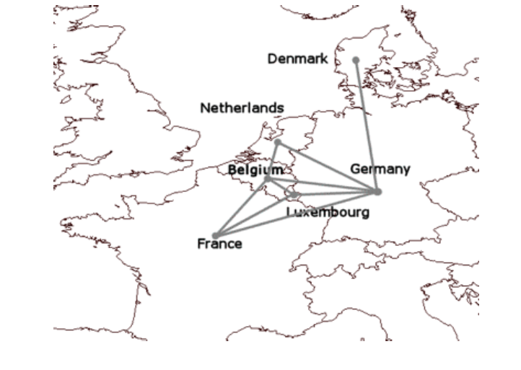
Adjacencies Between Countries

Slide 26
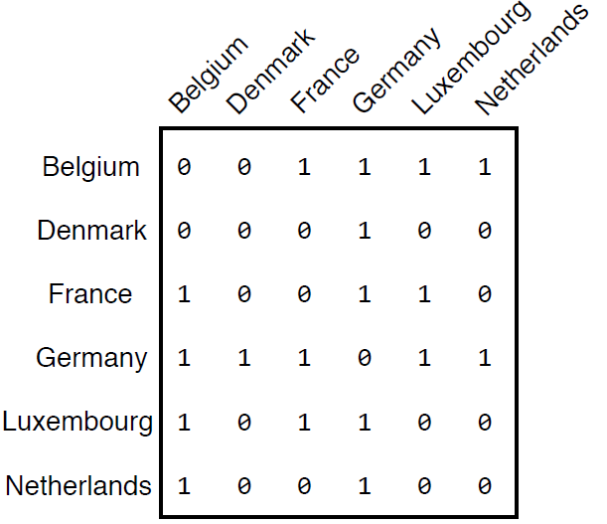
Adjacency Matrix

Slide 27
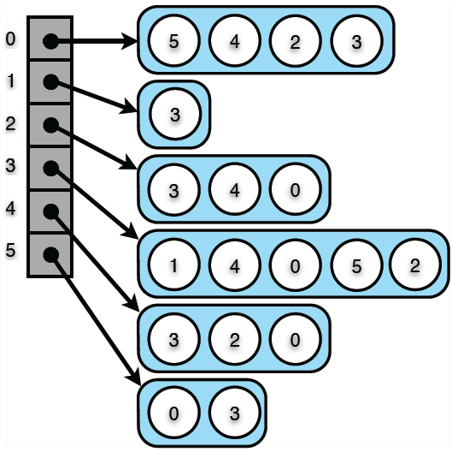
Adjacency List
Belgium = 0
Denmark = 1
France = 2,
Germany = 3
Luxembourg = 4
Netherlands = 5

Slide 28


Operation Time
Operation Adjacency List Adjacency Matrix
Scan incident edges $O(deg⁡(v)) O(|V|)$
Scan outgoing edges $O($out-deg$⁡(v)) O(|V|)$
Scan incoming edges $O($in-deg$⁡(v)) O(|V|)$
Test adjacency
of $u$ and $v$
$$O(min⁡(deg⁡(u), deg⁡(v)) O(1)$$
Storage $O(|V|+|E|) O(|{V|}^{2})$

